Slide 1
Intermediate Git

Slide 2

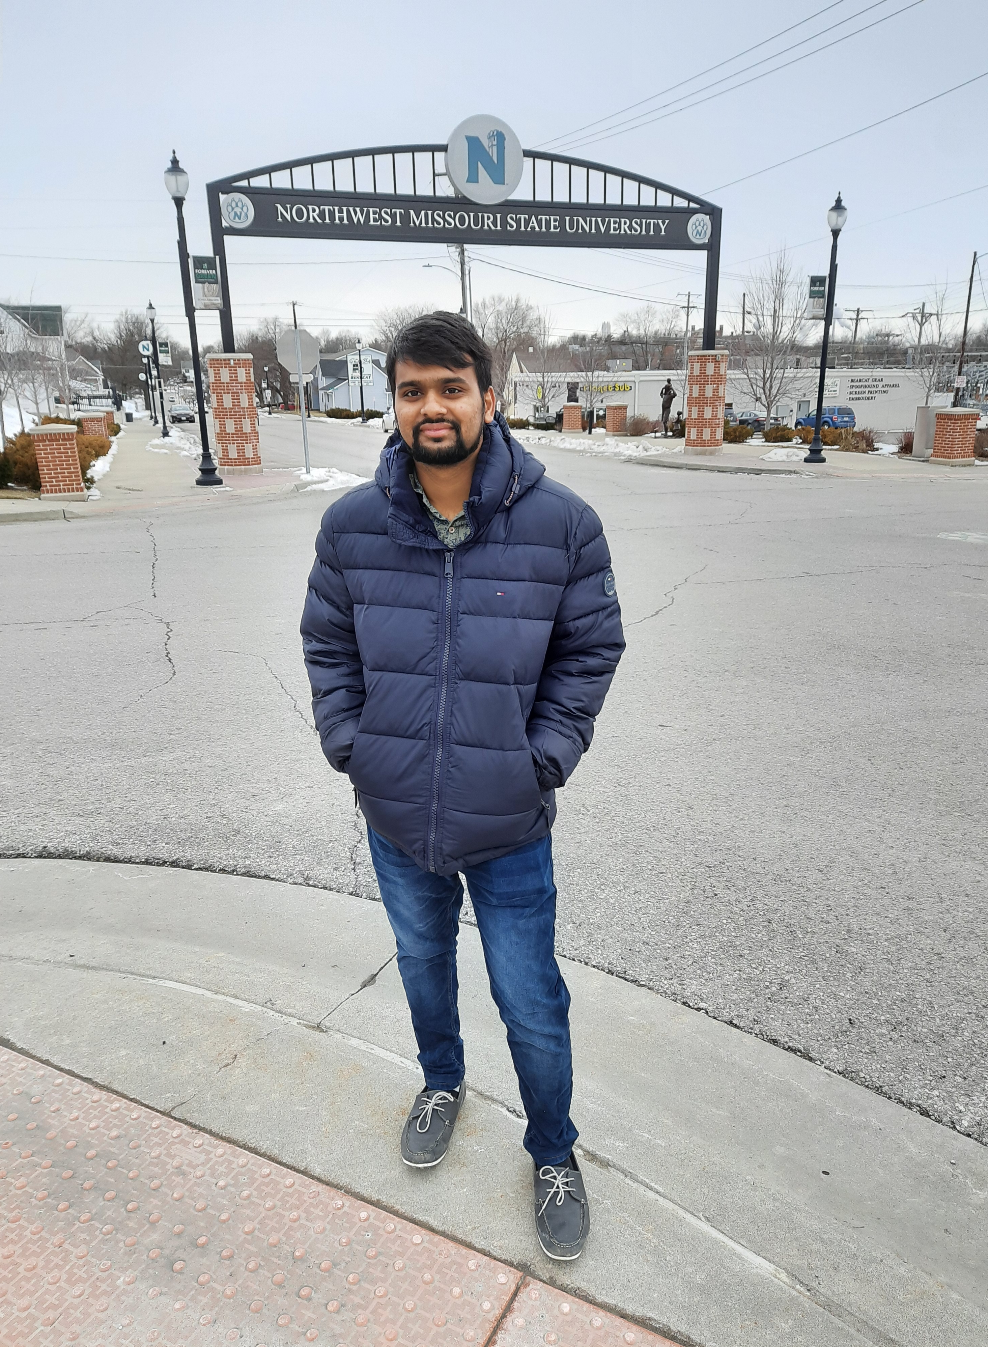

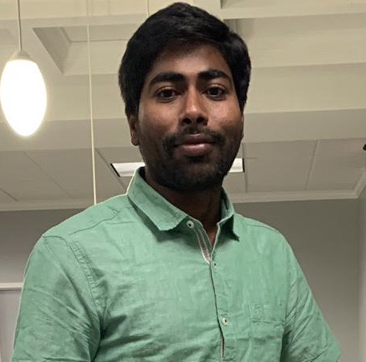
TEAM MEMBERS
Krishna Sumanth Koyyalamudi
Harish Thadka
https://github.com/harish24680
https://github.com/Krishna-Koyyalamudi
Vikas Baswapuram
Gopichand Bandarupalli
https://github.com/Vikas2004
https://github.com/chanduhvg

Slide 3
Agenda
Branching
Workflow
Merge Conflicts
Vikas Baswapuram

Slide 4
Branching
Branch in github represents another copy of the master branch(made at that point of time).
A Branch is used to work with different versions of a repository at a same time.
Gopichand

Slide 5
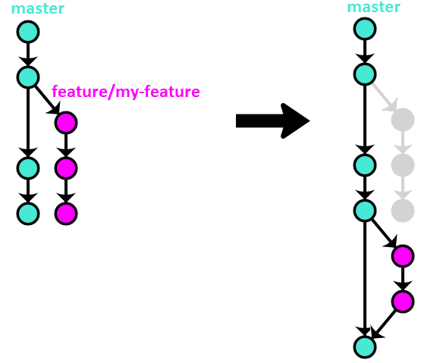
Continuation….
Gopichand

Slide 6
Workflow
Workflows are custom automated processes that you can set up in your repository to build, test, package, release, or deploy any project on GitHub.
With workflows you can automate your software development life cycle with a wide range of tools and services.
Krishna Sumanth

Slide 7
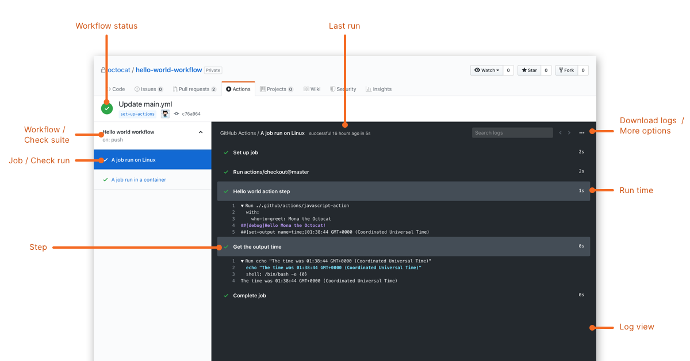
Krishna Sumanth

Slide 8
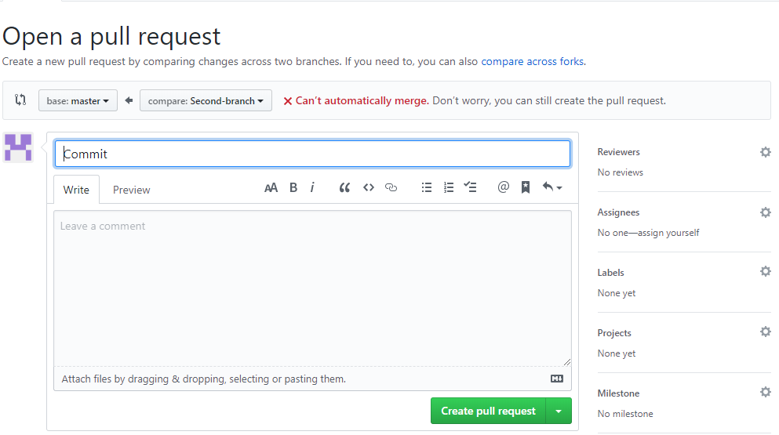
Merge Conflicts
Merge conflicts happen when you merge branches that have competing commits, and Git needs your help to decide which changes to incorporate in the final merge
Harish Thadka

Slide 9
Master Branch
1 Line1
2 Line2
3 Line3
4 Line4
5 Line5
6 Line6
1 L1
2 L2
3 L3
4 L4
5 Line5
6 Line6
Person A
Line 3&4 are Conflict
Read.me
Person B
Merge Pull request
1 Line1
2 Line2
3 Line3
4 Line4
5 Line5
6 Line6
1 Line1
2 Line2
3 L3
4 L4
5 L5
6 L6
Second Branch
Harish Thadka

Slide 10
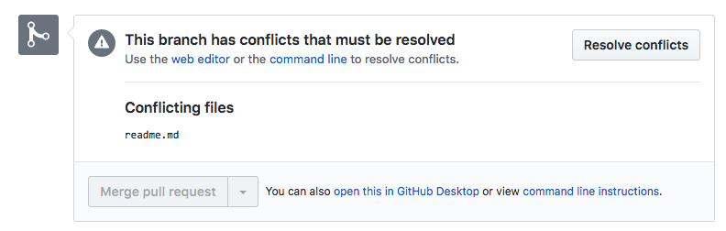
Continuation…
The Merge pull request button is deactivated until you've resolved all conflicts between the compare branch and base branch.
Harish Thadka

Slide 11
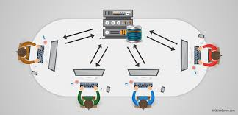
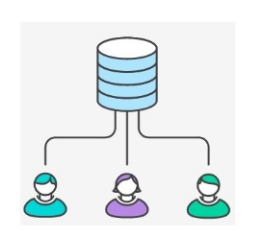
Advantages:
Vikas Baswapuram

Slide 12
Resources
https://www.w3schools.com/whatis/whatis_github.asp
https://help.github.com/en/actions/configuring-and-managing-workflows/configuring-a-workflow#about-workflows
https://help.github.com/en/github/collaborating-with-issues-and-pull-requests/about-merge-conflicts
https://www.youtube.com/watch?v=oPpnCh7InLY
https://www.youtube.com/watch?v=JtIX3HJKwfo&list=PLRqwX-V7Uu6ZF9C0YMKuns9sLDzK6zoiV&t=0s

Slide 13

Any Queries?

